Slide 1
Computer Organization & Assembly Language
THE STACK & Procedures

Slide 2
STACK
One dimensional data structure
Items are added and removed from one end of the structure i.e. Top of the Stack
Last In First Out Structure
.STACK directive used to reserve a block of memory for stack. The syntax is:
  .STACK 100h
When program is assembled and load in memory:
  SS (Stack Segment) Register: holds stack Segment Address
  SP (Stack Pointer) Register: initialized to the value specified with the .STACK directive, represents empty stack position
  When stack is not empty, SP represents the top of the Stack
  Stack grows toward the beginning of the memory.

Slide 3
PUSH And PUSHF
PUSH: Used to add a new source (16-bit register or memory word) on stack
Syntax:
PUSH source
Execution of PUSH causes:
  SP is decreased by 2
  A copy of source contents is moved to the address specified by SS:SP.
  Source remains unchanged
PUSHF has no operand and it pushes the contents of FLAG register onto the stack.

Slide 4
PUSH - Example
Offset
Stack
Offset
Stack
Offset
Stack
00F8
00FA
00FC
00FE
0100
00F8
00FA
00FC
00FE | 1234
0100
00F8
00FA
00FC | 5678
00FE | 1234
0100
SP
SP
SP
SP
0100
SP
00FE
SP
00FC
AX
1234
AX
1234
AX
1234
BX
5678
BX
5678
BX
5678
STACK EMPTY
After PUSH AX
After PUSH BX

Slide 5
POP And POPF
POP: Used to remove top item from stack to destination (i.e. a 16-bit register or memory word).
Syntax:
POP destination
Execution of POP causes:
  The contents of SS:SP (top of the stack) is moved to the destination.
  SP is increased by 2
POPF has no operand and pops the top of the stack into FLAG register.

Slide 6
POP - Example
Offset
Stack
Offset
Stack
Offset
Stack
00F8
00FA
00FC | 5678
00FE | 1234
0100
00F8
00FA
00FC
00FE | 1234
0100
00F8
00FA
00FC
00FE
0100
SP
SP
SP
SP
00FC
SP
00FE
SP
0100
CX
FFFF
CX
5678
CX
5678
DX
0001
DX
0001
DX
1234
Before POP
After POP CX
After POP DX (Stack Empty)

Slide 7
STACK Application
To store and restore registers
To reverse an input

Slide 8
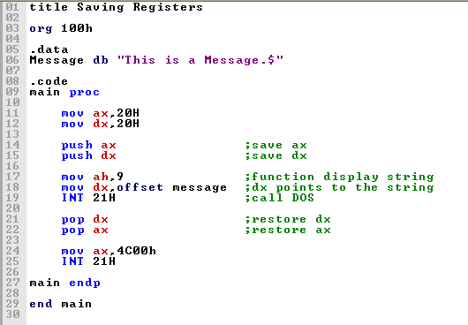
Saving & Storing Registers

Slide 9
Algorithm to Reverse an Input
Convert the following algorithm to Assembly Language code:
Display a “?”
Initialize count to 0
Read a character
WHILE character is not carriage return Do
push character onto the stack
increment count
read a character
END_WHILE
Go to a new line
For count times Do
pop a character from the stack
display it
END_FOR

Slide 10
For Practice
Exercise Ch#8: Q2, Q3, Q6, and Q8.

Slide 11
Procedures

Slide 12
Creating Procedures
Large problems can be divided into smaller tasks to make them more manageable
A procedure is the assembly equivalent of a Java or C function
Following is an assembly language procedure named sample:
sample PROC
  .
  .
  ret
sample ENDP

Slide 13
Procedure call and return
MAIN PROC
CALL PROC1
First instruction
PROC1 PROC
First instruction
RET

Slide 14
CALL and RET Instructions
The CALL instruction calls a procedure
  pushes offset of next instruction on the stack
  copies the address of the called procedure into IP (Note: IP=Instruction Pointer)
The RET instruction returns from a procedure
  pops top of stack into IP

Slide 15
Before Call
MAIN PROC
Offset
Stack
0010
0012
CALL PROC1
First instruction
00F8
00FA
00FC
00FE
0100
IP
PROC1 PROC
First instruction
0200
SP
RET

Slide 16
After Call
MAIN PROC
Offset
Stack
0010
0012
CALL PROC1
First instruction
00F8
00FA
00FC
00FE | 0012
0100
PROC1 PROC
First instruction
SP
IP
0200
RET

Slide 17
Before RET
MAIN PROC
Offset
Stack
0010
0012
CALL PROC1
First instruction
00F8
00FA
00FC
00FE | 0012
0100
PROC1 PROC
First instruction
SP
0200
IP
0300
RET

Slide 18
After RET
MAIN PROC
Offset
Stack
0010
0012
CALL PROC1
First instruction
00F8
00FA
00FC
00FE
0100
IP
PROC1 PROC
First instruction
0200
SP
0300
RET

